Slide 1

CAR FEATURES AND MSRP ANALYSIS
Akshat Sharma
PGA 03

Slide 2

Introduction
The dataset originates from Kaggle and comprises approximately 12,000 car models sold in the USA from 1990 to 2018, along with their market prices (new or used) and various features. Our analysis will involve conducting exploratory data analysis (EDA) using SQL and Power BI dashboard tools, rather than relying on pandas plot and matplotlib, to derive insights and conclusions from the dataset.

Slide 3
Problem Description
Amidst the automotive industry's rapid expansion, focus has shifted towards fuel efficiency, environmental sustainability, and technological advancements. This evolution includes the rising popularity of electric, hybrid, and alternative fuel vehicles. Despite these advancements, traditional gasoline-powered cars remain prevalent, offering various fuel types and grades. To optimize pricing and product development strategies, manufacturers must analyze the interplay between vehicle features, market segments, and pricing trends. This analysis enables them to identify popular features and profitable market categories, thus guiding strategic decision-making in a dynamic automotive landscape.

Slide 4
Dataset
• Company: the make or brand of the car
• Model: the specific model of the car
• Year: the year the car was released
• Engine Fuel Type: the type of fuel used by the car (gasoline, diesel, etc.)
• Engine HP: the horsepower of the car's engine
• Engine Cylinders: the number of cylinders in the car's engine
• Transmission Type: the type of transmission (automatic or manual)
• Driven_Wheels: the type of wheels driven by the car (front, rear, all)
• Number of Doors: the number of doors the car has
• Market Category: the market category the car belongs to (Luxury, Performance, etc.)
• Vehicle Size: the size of the car
• Vehicle Style (or) Body Style : the style of the car (Sedan, Coupe, etc.)
• Highway MPG: the estimated miles per gallon the car gets on the highway
• City MPG: the estimated miles per gallon the car gets in the city
• Popularity: a ranking of the popularity of the car (based on the number of times it has been viewed on Edmunds.com)
• Price: the manufacturer's suggested retail price of the car

Slide 5
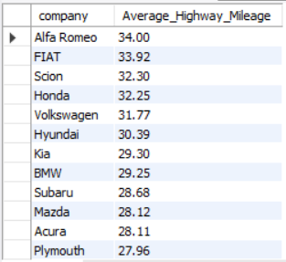
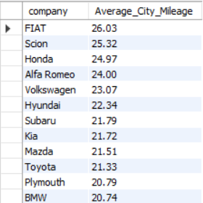
SQL Queries
Average of highway and city mileage.
Highway
select company, round(avg(highway_MPG), 2) as Average_Highway_Mileage
from data
group by company
order by Average_Highway_Mileage desc;
City
select company, round(avg(city_mpg), 2) as Average_City_Mileage
from data
group by company
order by Average_City_Mileage desc;

Slide 6
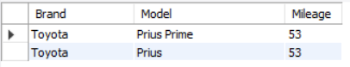
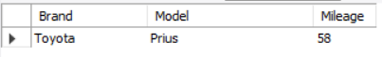
Which model has best mileage?
Highway
select company as Brand, Model, highway_MPG as Mileage
from data
where highway_MPG in (select max(highway_MPG) from data where Engine_Fuel_Type != "electric")
group by company, Model, Engine_Fuel_Type, highway_MPG;
City
select company as Brand, Model, City_MPG as Mileage
from data
where City_MPG in (select max(City_MPG) from data where Engine_Fuel_Type != "electric")
group by company, Model, Engine_Fuel_Type, City_MPG;

Slide 7
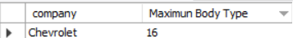
Which brands has maximum Body type?
select company as Brand, Model, highway_MPG as Mileage
from data
where highway_MPG in (select max(highway_MPG) from data where Engine_Fuel_Type != "electric")
group by company, Model, Engine_Fuel_Type, highway_MPG;

Slide 8
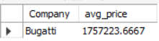
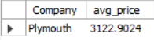
Which company produces the most expensive vehicles on average?
with subq as
(select Company, avg(Price) as avg_price from data
group by Company)
select * from subq
where avg_price = (select max(avg_price) from subq);
Which company produces the most cheapest vehicles on average?
with subq as
(select Company, avg(Price) as avg_price from data
group by Company)
select * from subq
where avg_price = (select min(avg_price) from subq);

Slide 9
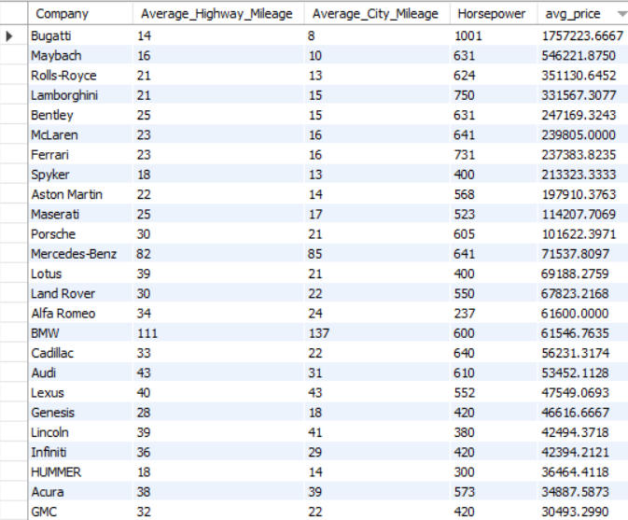
How does the variation in horsepower, miles per gallon (MPG), and price differ across different car brands?
select Company, round(avg(highway_MPG), 2) as Average_Highway_Mileage, round(avg(city_mpg), 2) as Average_City_Mileage, round(max(Engine_HP), 2) as Horsepower, avg(Price) as avg_price
from data
group by Company;

Slide 10
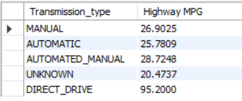
What is the average highway MPG (miles per gallon) of every transmission type?
select Transmission_type, max(Highway_MPG) as "Highway MPG“
from
(select Transmission_type, avg(Highway_MPG) as Highway_MPGfrom datagroup by Transmission_Type) as subquery
group by Transmission_type;

Slide 11
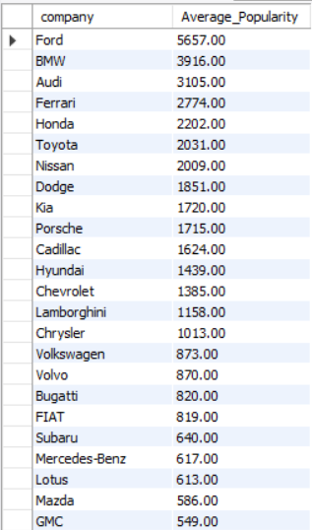
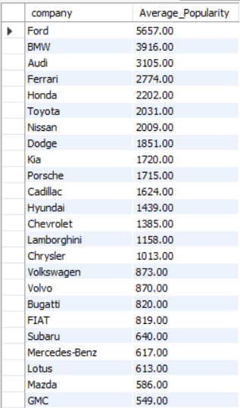
What is the average popularity of every company?
select company, round(avg(Popularity), 2) as Average_Popularity
from data
group by company
order by Average_Popularity desc;

Slide 12
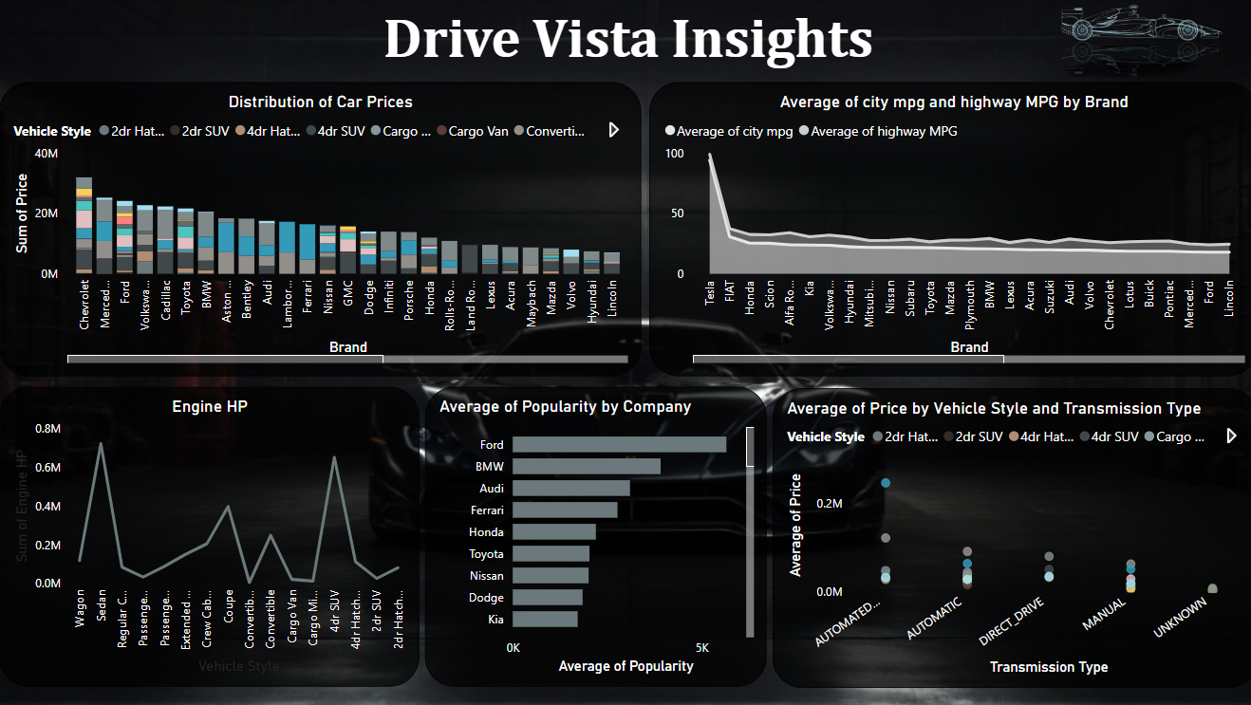
Dashboard (Page 1)

Slide 13
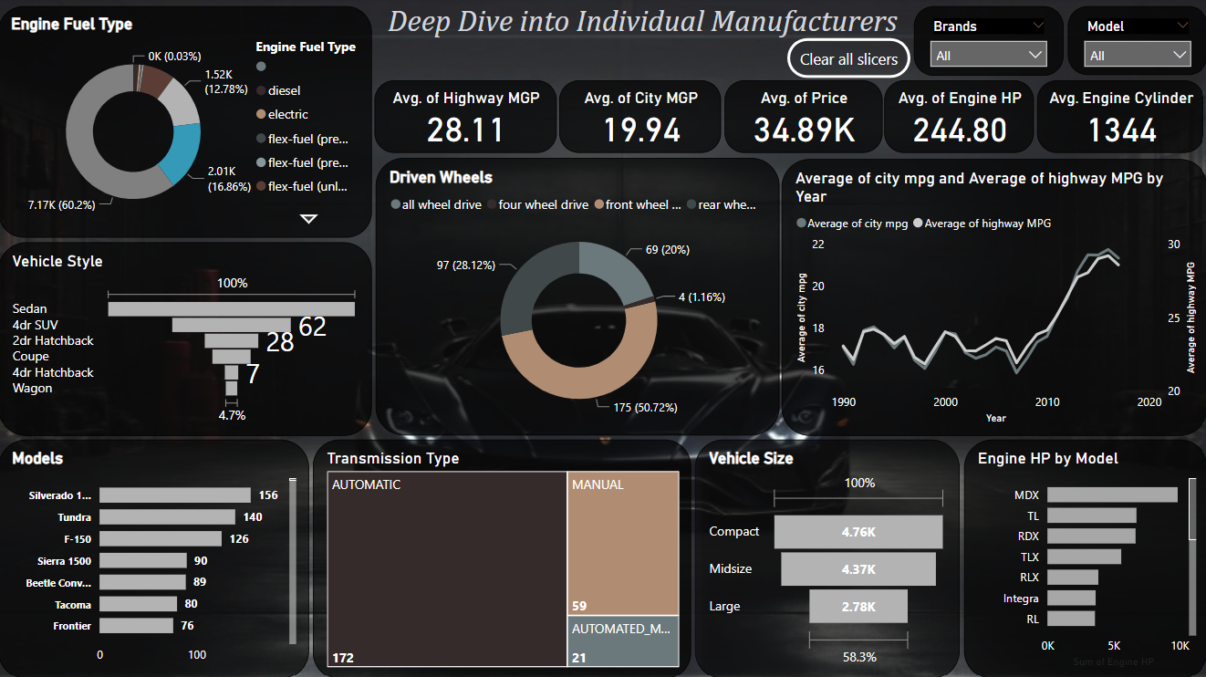
Dashboard (Page 2)

Slide 14
Insights
Popularity by Market Category:
• The market category “Flex Fuel” has the highest popularity with a total of 19,33,488 models. It is closely followed by the market category “Crossover” with a popularity of 16,86,521.
• Although the market category “Flex Fuel” has highest popularity then “Crossover”, the models present in the market for “Crossover” is more then “Flex Fuel”.
• The market category “luxury”, “luxury performance”, and “performance” have relatively lower popularity, but they have a significant number of models present in the market.
Price Variation Based on Engine Power:
• There is a clear relationship between Engine HP and car prices. As the Engine HP increases, the average cost of the car also increases.
• For example, cars with an Engine HP of 55 have an average cost of $2,000, while cars with an Engine HP of 1001 have an average cost of $17,57,223.67.

Slide 15
Relative Importance of Car Features on Price:
• According to the regression analysis, the car feature that has the least importance on the price of the vehicle is “vehicle size”. On the other hand, the “engine cylinder” has the highest importance.
• Other features that show relative importance in determining the price of a car include “City MPG”, “Highway MPG”, “engine HP”, “vehicle style”, and “engine fuel type”.
Price Comparison Across Manufacturers:
• “Bugatti”, “Maybach”, and “Rolls Royce” are the manufacturers with the highest average prices for cars.
• “Bugatti” has the highest average price range, while “Plymouth” has the lowest average price range among the manufacturers.

Slide 16
Car Price Distribution by Brand and Body Style:
• The distribution of car prices varies by brand and body style. Different brands and body styles have different price ranges.
• For example, “Genesis” only manufactures “Sedans” with an average MSRP of $1,39,850, while “Chevrolet” offers various body styles, with “Sedans” having a total MSRP of $30,68,812.
Exploring Variation in Horsepower, MPG and Price Across Car Brands:
• Different car brands offer varying levels of engine horsepower, city MPG, highway MPG, and price.
• For instance, “BMW” provides a balance between engine horsepower (326), city MPG (20.74), highway MPG (29.25), and an average price of $61546.76. On the other hand, “Bugatti” offers high horsepower (1001), low MPG, and a significantly higher average price of $17,57,223.

Slide 17
Key findings
Car prices vary by brand and body style, with brands like Bugatti, Maybach, and Rolls Royce commanding higher prices.
Engine horsepower significantly influences car prices, indicating customer preference for higher performance.
Car features such as engine cylinder count, MPG, horsepower, vehicle style, and fuel type impact pricing decisions.
Variations in fuel efficiency are observed across body styles and model years, guiding consumers towards more fuel-efficient options.
Toyota is the only company which has best highway and city MGP

Slide 18

Thank You

